Slide 1

Forecasting of Employee salary
2021

Slide 2
What is
Forecasting of Employee’s salary ?
It is a model enable Stakeholder like MOF, Sponsors, companies, Business owners, and project managers to predict what they will spend on their employees based on their years of experience.
01

Slide 3
From where Came the pain!
Previously before Vision 2030, more than half of Saudi budget spent on Salaries
due to :
no monitoring system.
no salary scale
We don't show an inflated number of employees
4. The company asks for a larger budget than the need for employee salaries.
02

Slide 4
What is
Purpose of this project?
Help in strategic Planning
4
3
2
Internal corporate planning
1
Measuring and forecasting
Measuring result and performance
03

Slide 5
01
The workflow
W2
Looking for dataset
W2
Find the topic: Health Care Insurance Fraud Detection
W1
Looking for spark!
المرحلة الرابعة
المرحلة الثالثة
المرحلة الثانية
3
2
1
4
5
6
7
W3
Changing the dataset Many time!
W3
Changing the Topic
Fraud Detection
W4
Use local dataset
W4
Changing the topic and the dataset
9
8
8
W4
Model
W4
EDA
W4
Cleaning Data
04
Do not start yet
InProgress
Done

Slide 6
Dataset
Using dataset from Kaggle for 4 years (2011,2012, 2013, and 2014) it simulated the confidential data frame that I have.
Dataset include 148654 records and 13 features
as fellow:
Id EmployeeName JobTitle BasePay OvertimePay OtherPay Benefits TotalPay TotalPayBenefits Year Notes Agency Status
05

Slide 7
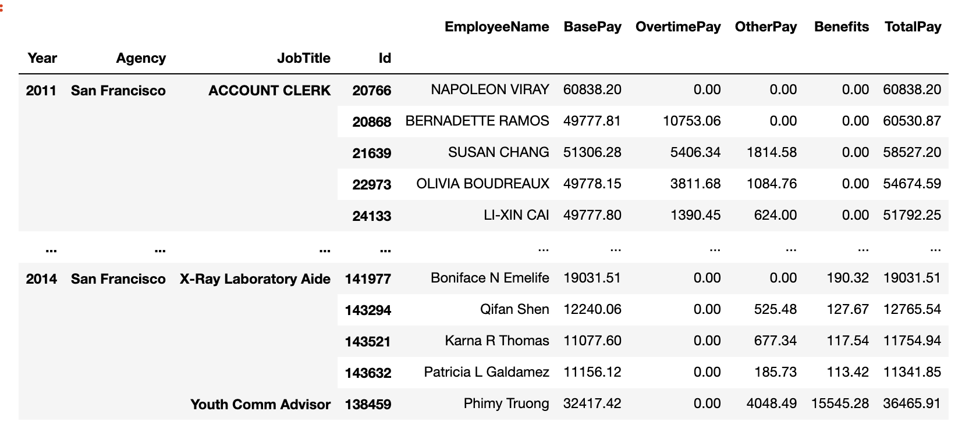
Cleaning Process
Changing Datatype
4
3
2
negative values
1
null values
duplication
06
Notes:
List the issues
Present last result.

Slide 8

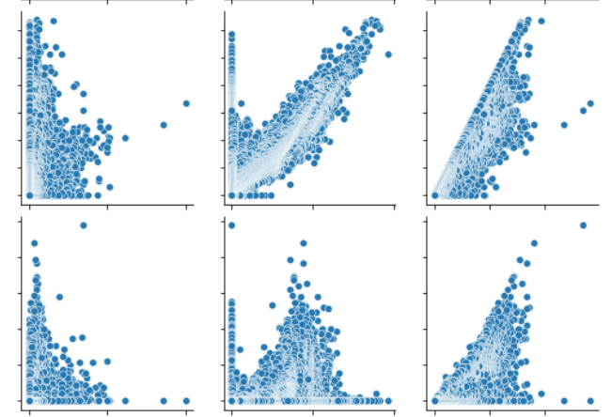
Some of finding
overview
07

Slide 9
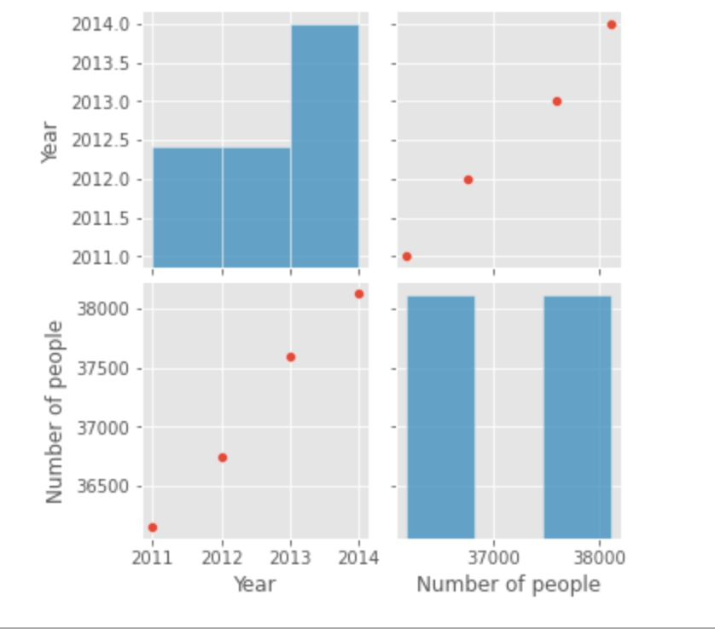
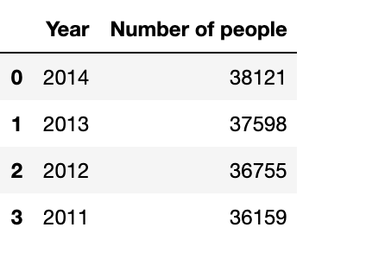
Some of finding
How many employees
08

Slide 10
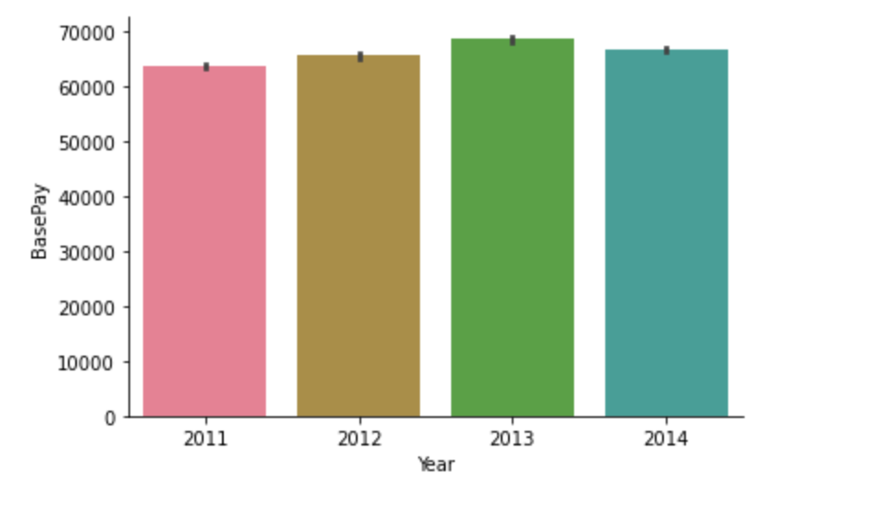
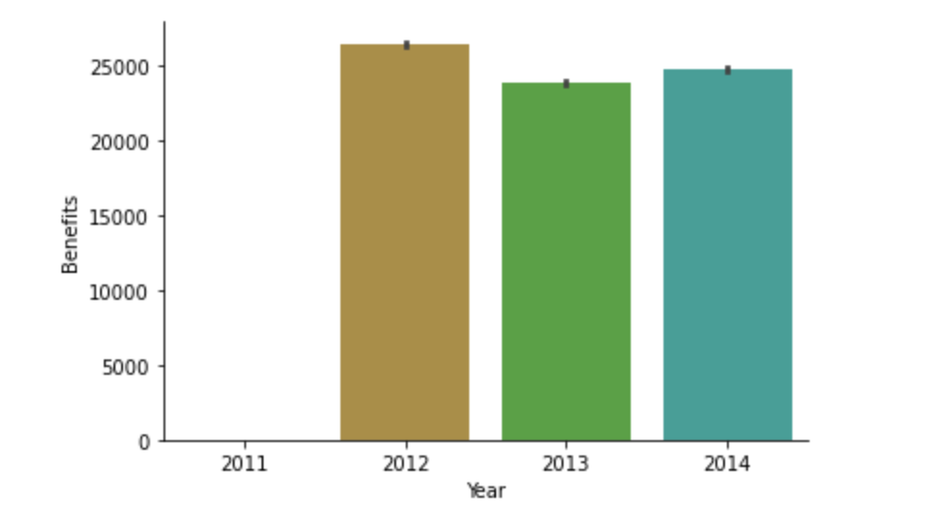
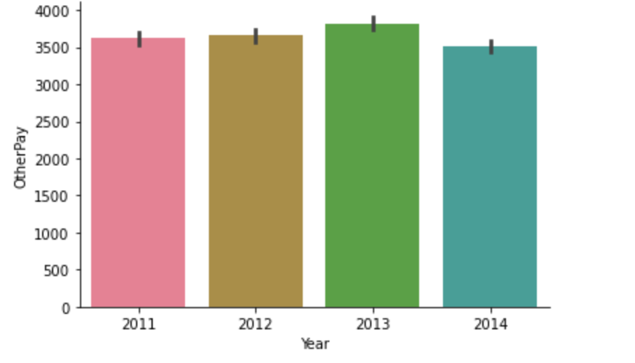
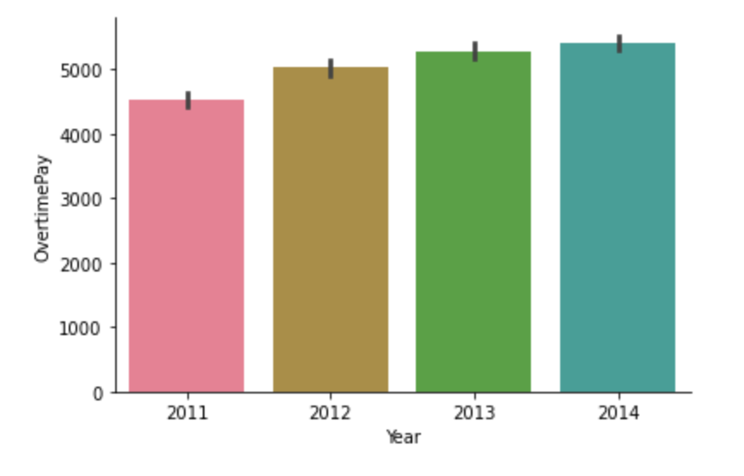
Some of finding
The majority of budget spent in different years
09
Notes:
Where is the majority of budget goes for?

Slide 11
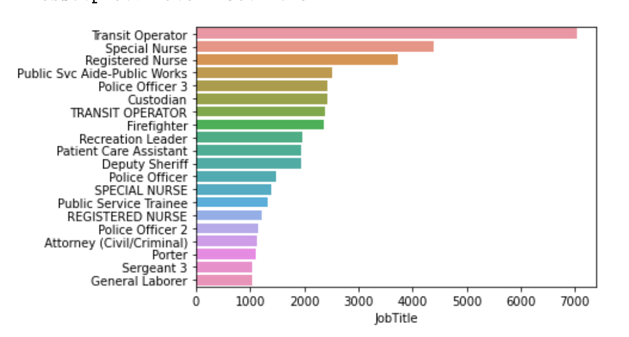
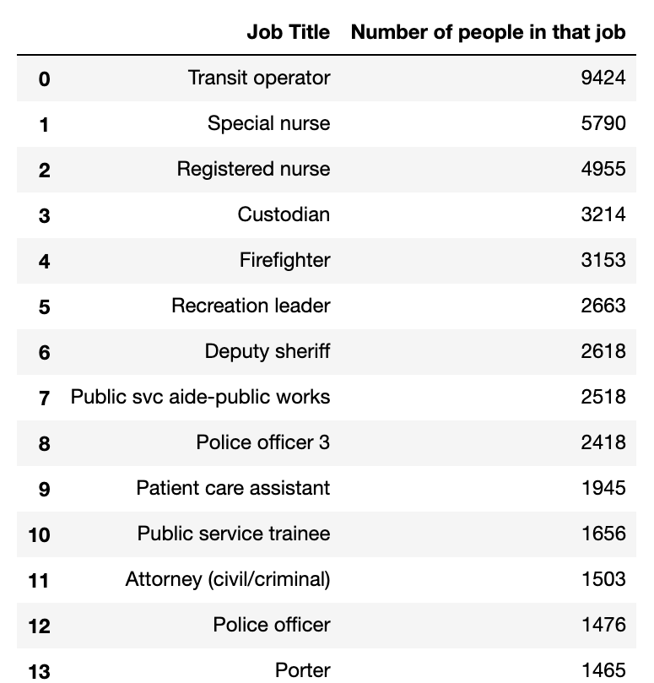
Some of finding
The main question was what is the job title with highest spending.
10
Notes:
Nowing number of emoloyess? Done
- How many employees left in each years?
What about their spending in each years Done
How many employees in one job title? Done
How many job title per year and how many new one?

Slide 12
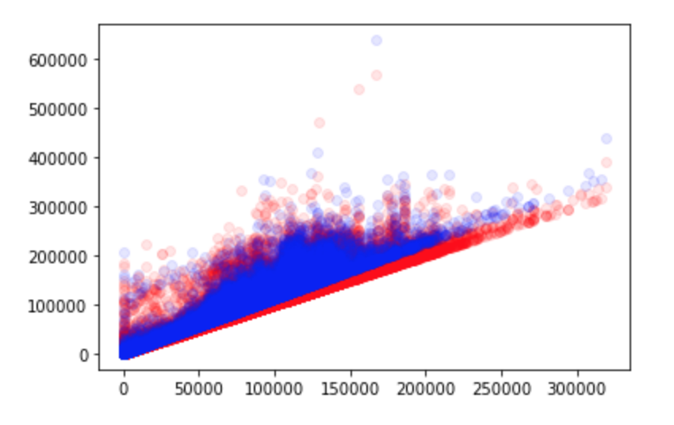
Model1
I built model to predict relation x.BasePay and y.TotalPay.
Accuracy(0.6171)
11

Slide 13
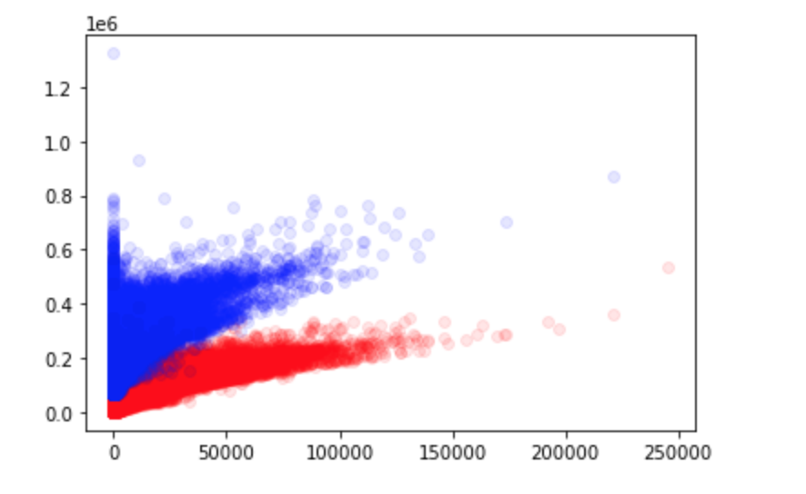
Model2
I built model to predict relation x. OvertimePay and y.TotalPay.
Accuracy(0.6171)
12

Slide 14
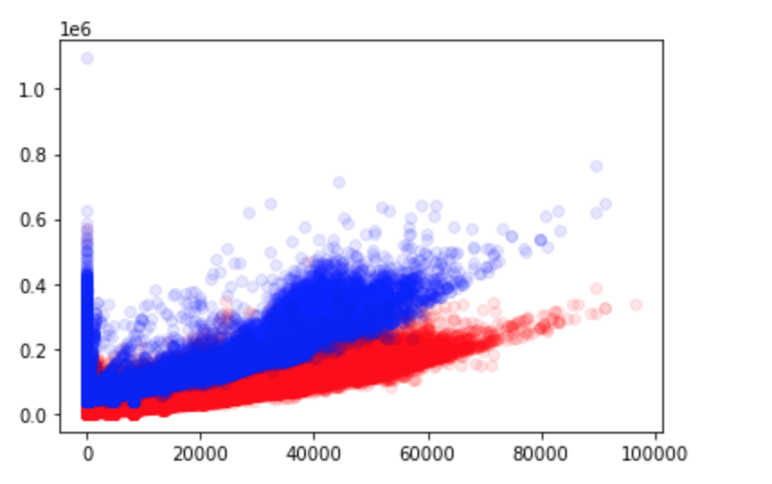
Model3
I built model to predict relation
x.Benefits and y.TotalPay.
Accuracy(0.6171)
13

Slide 15
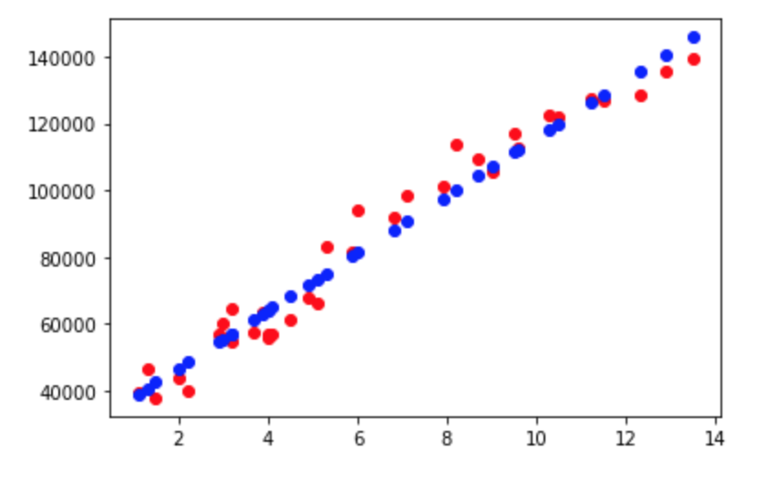
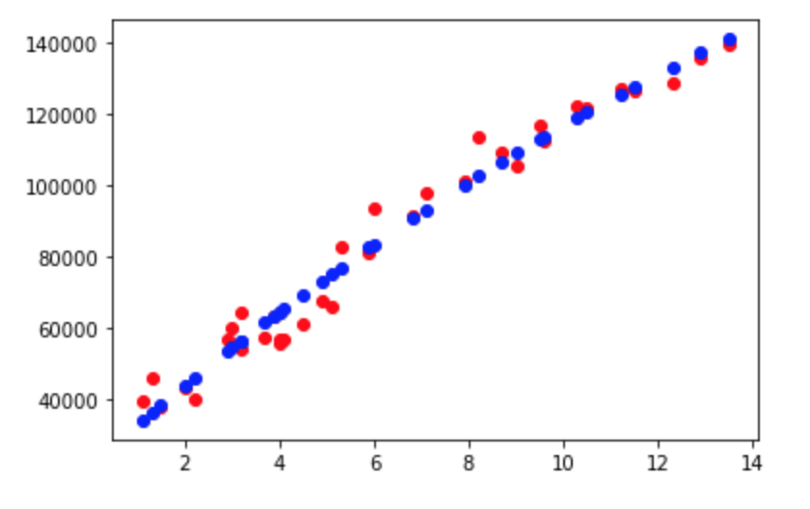
Model4
Trying to predict what they salary for employees based on their years of experience.
11

Slide 16
At the end
Thanks to have this journey☺
12

